Slide 1



INTRODUCTION TO
Introduction to Django Templates
A Step-by-Step Guide for Beginner Web Developers
PRESENTED BY
DATE OF SESSION
Muhammd Yousif Memon
July 22, 2026

Slide 2
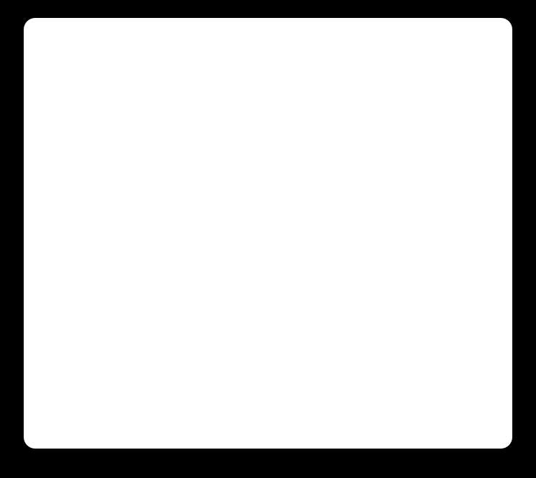
Django's MVT Architecture
Django's MVT (Model-View-Template) architecture dictates how data flows and is presented.
MODEL
VIEW
TEMPLATE
storage
settings
web
This component is responsible for managing data and all database operations.
The View handles the core application logic and processes incoming requests. It acts as the intermediary, fetching data from the Model and passing it along.
The Template handles the presentation layer, determining what the user sees in the browser.
In this workflow, the View prepares the necessary data and sends it to the Template. The Template then uses this data to generate the final HTML response that is sent back to the user's browser. This clear separation ensures that application logic and presentation remain distinct.
Introduction to Django Templates | Beginner Web Development

Slide 3
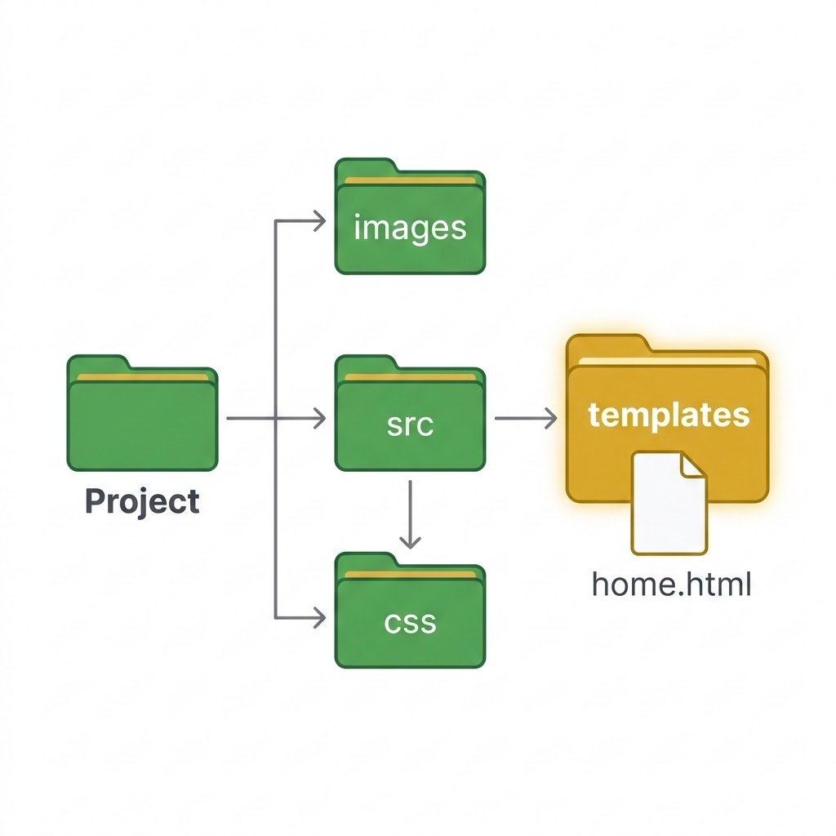
Django Project Templates
To organize your Django project, templates are typically stored within a dedicated folder named templates. In a standard project setup, you would create this templates folder at the project level, in the same directory where your manage.py file is located.
Initial Configuration
Your project structure will look something like this:
Template File Creation
Inside this newly created templates folder, you can add your HTML template files. For example, you might create a file named home.html. The structure then becomes:
myproject/
├── manage.py
├── templates/
├── myapp/
└── myproject/
myproject/
├── manage.py
├── templates/
└── home.html
├── myapp/
└── views.py
└── myproject/
├── settings.py
└── urls.py
Introduction to Django Templates | Beginner Web Development

Slide 4
Configuring Template Directories
Django Settings Update
TEMPLATES Configuration
Once the templates folder is created, Django must be configured to locate it. This is done in the myproject/settings.py file within the TEMPLATES configuration section.
By default, the DIRS option in this section is an empty list [].
You must modify the DIRS option to include the path to your templates folder:
'DIRS': [BASE_DIR / 'templates']
BASE_DIR represents the main directory of your Django project. By adding this path, you explicitly instruct Django to search for HTML template files inside that folder.
TEMPLATES = [
{
'BACKEND': 'django.template.backends.django.DjangoTemplates',
'DIRS': [BASE_DIR / 'templates'],
'APP_DIRS': True,
...
},
]
Introduction to Django Templates | Beginner Web Development

Slide 5
Django Views & Rendering
How Views Work
Basic View Example
Handling Request & Response
A Django View receives an incoming browser request and returns a corresponding response. To display a template, you must create a View function dedicated to rendering it.
The render() Function
In your myapp/views.py file, you import and use the render() function from django.shortcuts.
The request parameter carries information about the browser request. When executed, Django locates home.html, processes it, and displays the final HTML page in the browser.
myapp/views.py
from django.shortcuts import render
def home(request):
return render(request, 'home.html')
Introduction to Django Templates | Beginner Web Development

Slide 6
Displaying Dynamic Data
A primary advantage of Django Templates is displaying dynamic data. You can pass data from a Python view to an HTML template using a context dictionary.
1. View Setup (views.py)
2. Template Rendering (home.html)
Modify the view to include a context:
Inside home.html, use double curly brackets { } to display the variable:
def home(request):
context = {'name': 'Ali'}
return render(request, 'home.html', context)
<h1>Welcome { name }</h1>
When Django processes this, it replaces { name } with Ali, resulting in the browser displaying:
Here, context is a Python dictionary. The key 'name' becomes a variable accessible inside the template.
BROWSER OUTPUT
Welcome Ali
Introduction to Django Templates | Beginner Web Development

Slide 7
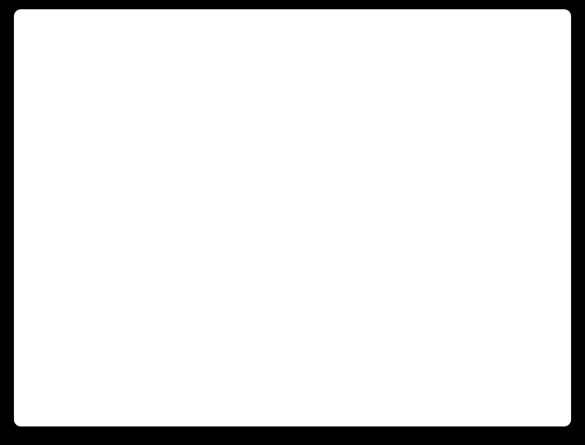
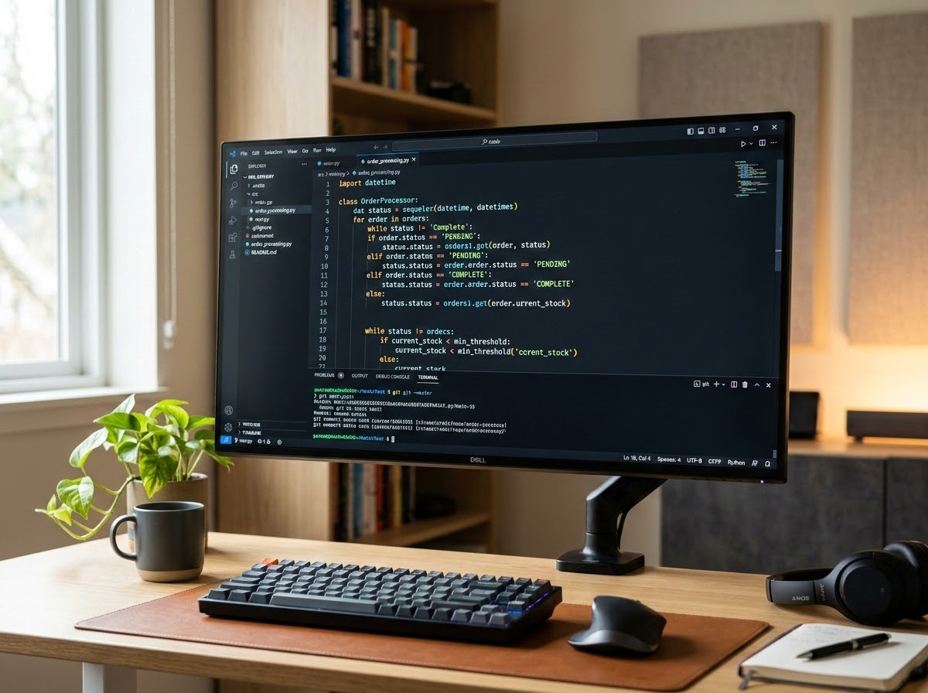


Template Tags
Django Templates provide Template Tags, allowing you to add simple programming logic inside HTML templates without writing Python code directly. Template tags use the syntax {% %}.
If Condition: You can use an {% if %} tag for conditional logic.
{% if name %}
<h1>Welcome { name }</h1>
{% endif %}
For Loop: You can use a {% for %} tag to iterate over lists sent from the view.
If the view sends context = {'students': ['Ali', 'Ahmed', 'Sara']}:
<h2>Students</h2>
{% for student in students %}
<p>{ student }</p>
{% endfor %}
Django will repeat the paragraph for every student, outputting Ali, Ahmed, and Sara.
Editor View: Code editor displaying structural syntax highlighting on logic tag statements.
Introduction to Django Templates | Beginner Web Development

Slide 8

Template Inheritance
Parent Layout (base.html)
Child Template (home.html)
Template Inheritance allows you to reuse common HTML structure (headers, footers, navigation) across multiple pages to avoid code repetition.
Child templates extend the parent layout using {% extends 'base.html' %}. Django replaces the designated blocks with child-specific markup.
templates / home.html
Header & Navigation Bars
{% extends 'base.html' %}
{% block content %}
<h2>Welcome to the Home Page</h2>
{% endblock %}
{% block content %}
[Dynamic Child Page Content Injected Here]
{% endblock %}
Common Footer
Introduction to Django Templates | Beginner Web Development

Slide 9
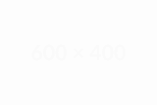
THANK YOU
Thank You for Your Time
We hope this session provided valuable insights into the fundamental principles of electronics and robotics.
QUESTIONS
Any Questions?
Feel free to ask any questions about the concepts covered today, including voltage, current, resistance, or template workflows.
Interactive Q&A Session
Introduction to Django templates| Robotics and Automation Systems
Government of Sindh | University of Sindh

